Slide 1
Teaching Graphicacy: Reading More Than Words Part II
ATIA 2012
Orlando FL

Slide 2
Dawn Wilkinson, M.Ed.
Assistive Technology Consultant
Technology and Curriculum Access Center
Easter Seals Arkansas
http://eastersealsar.com/tcc-training-page

Slide 3
Technology and Curriculum Access Center
A program operated by Easter Seals Arkansas in collaboration with the Arkansas Department of Education, Special Education Unit and the Southwest American’s with Disabilities Act Center DBTAC
501-227-3604
Toll-free: 877-533-3600
Fax: 501-227-3601
dwilkinson@eastersealsar.com
http://eastersealsar.com/tcc-training-page

Slide 4
Lucia Hasty. MA, CTVI
Braille & Tactile Graphics Consultant
Rocky Mountain Braille Associates
www.tactilegraphics.org

Slide 5
Workshop Objective 1
How interpreting tactile graphics relies on spatial concepts and discover resources for teaching these skills.

Slide 6
Workshop Objective 2
Sequence of basic skill development in a continuum required for interpreting a tactile graphic

Slide 7
Workshop Objective 3
How tactile graphics serve to teach spatial concepts and discover resources for teaching these skills.

Slide 8
Introduction
About the curriculum
About the continuum

Slide 9
Graphicacy
Visually rich environment
Sighted learners- constantly entertained with graphics
Written communication increasingly image-dependent

Slide 10
Graphicacy
Essential component of literacy
Often overlooked
Rarely taught

Slide 11
Why graphicacy is important
Access to
textbooks
leisure activities
standardized/high stakes tests

Slide 12
Why graphicacy is important
Functioning as an adult
map reading/vacation
planning
communication with others
(remodeling the kitchen)

Slide 13
Why graphicacy is important
Developing your own
professional and personal
skills
iPhone book
Windows 7
Print symbols (math,music)

Slide 14
The Power of Graphic Literacy and Technology
Dr. Kent Cullers, the world’s first blind astronomer said it this way in the book, Touch the Universe: “It has often been said that a picture is worth a thousand words. Well, for the first time in my career, I get the picture.”
http://www.youcandoastronomy.com/

Slide 15
From a parent’s point of view
Tactile information in your environment
Supporting your children in
their academics

Slide 19
The Higher Ed. DSS offices are saying …
Students can’t read or “write” graphics
Students don’t know Nemeth Code
Students aren’t flexible in using different access technologies

Slide 20
Tasks in Decoding a Graphic
Understand intent of graphic
Decode symbols
Interpret content of graphic
Apply content to task

Slide 21
For Older Readers
Identify characteristics/significant elements of image-
land/water on a map,
blood flow direction on an anatomy diagram
the sides of a polygon shown in 3-D
Use the tools to communicate through drawing/writing graphic representations

Slide 22
Required Skills for Successful Graphic Reading
System for
Scanning graphic and key
Searching for specific information
Ability to identify attributes of symbols used in graphic
Rough line means rivers, smooth line means state boundaries

Slide 23
Tactile complexity
vs
Conceptual complexity

Slide 24
Visual Principles
Perspective
Occlusion
Refection
Mirror image
Transparency
Transposition
Transformation
Rotation

Slide 25
Successful Readers Ask:
1.Where am I?
Look for title
Scan whole graphic and key
Identify a point of reference
2. Where am I going?
Look for important clues, prominent textures
Compare area textures, trace major and minor
lines, examine point symbols

Slide 26
Successful Readers Ask, cont’d:
3. What am I looking for?
Search key for details
Read labels
4. How do these pieces fit together?
Actually starts reading the graphic rather than scanning it.
Moves more slowly and intently
Begins to put parts into whole picture

Slide 27
Tools for Graphicacy-Math
Geometro
Stack-ups
Polydrons
TTP calculators
Geometry Tactile Graphics
Tangible Graphs

Slide 28
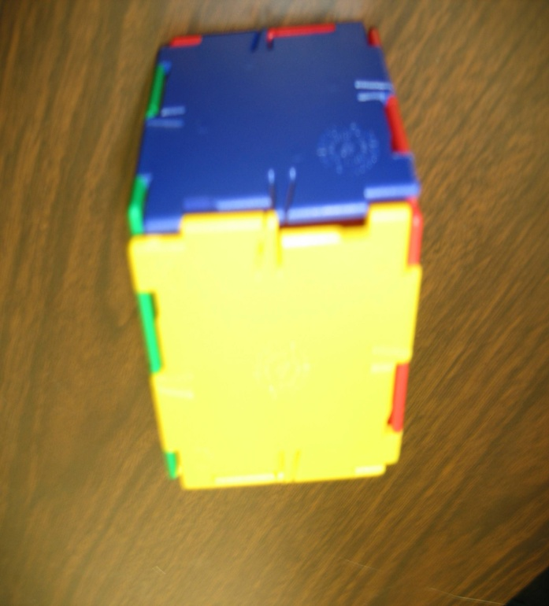
Concrete-Representational and Abstract (single dimensions to multiple dimensions)

Slide 29
Tools for Graphicacy- Science
Periodic Table of Elements (APH and Touch Graphics)
APH Science series
TTP science graphics
Independence Science
Touch the … Series (astronomy)

Slide 30
Tools for Graphicacy- Social Studies and Geography
World Maps (APH, Princeton Braillists, Tactile Vision Inc, Touch Graphics)
Consumable outline maps (APH, Coloring pages resources, publishers’ websites

Slide 31
Building Mental Images
The learning process:
Concrete 3-dimensional
Manipulative
Abstract 2-dimensional
solid drawing
outline shape

Slide 32
Building Mental Images
1. Exposure
2. Experience
3. Exploring
4. Enthusiasm

Slide 33
Role of Language
4 C’s of Communication:
Compare
Categorize
Comprehend
Communicate
Notes:
London bus story

Slide 34
1. Exposure
Active involvement with others in the environment
Experience, as opposed to “just” language
Developing concepts of “chair-ness”, “nose-ness”
Begin to Identify characteristics and features of things encountered

Slide 35
2. Experience
Opportunity to tie things exposed to together
Begin to establish how they are related
Manipulate within the environment
(using manipulatives is vital!)
Match language with experience

Slide 37
3. Exploring
Independently explore with intent of gathering information
Requires
Spatial awareness
Organized scanning skills
Part-to-whole assembly
Tactual discrimination (identifying symbols, selecting landmarks)
Language skills (labels, etc.)

Slide 38
4. Enthusiasm
Success at finding information independently
Curiosity increases
Becomes “do-er” as opposed to “done to”
Positive self-concept

Slide 39
Curriculum Highlights
Sequence of skill development
Existing resources for teaching each skill
Additional recommended activities
Tactile Strategies (for the learner)
Listing of skills required for high-stakes tests, by grade level
Evaluation tools (checklists of competencies)
Extensive resource list

Slide 40
Example of skills checklist

Slide 41
Graphics Resources
www.aph.org
www.humanware.com
www.nbp.org
http://mysite.verizon.net/resvqbxe/princetonbraillists
www.nationalbraille.org
www.tactilevisioninc.com
www.touchgraphics.com
www.youcandoastronomy.com
www.viewinternational.org

Slide 42
Contact Us!
If you are interested in
Suggesting content or topics
Field testing curriculum
Additional information on topics we covered today

Slide 43
Download this powerpoint
www.TactileGraphics.org
Email:
Lucia@tactilegraphics.org
dwilkinson@eastersealsar.com

