Slide 1
Teaching Graphicacy:
Reading More Than Words
Part I
ATIA Orlando 2012
Orlando, FL

Slide 2
Dawn Wilkinson, M.Ed.
Assistive Technology Consultant
Technology and Curriculum Access Center
Easter Seals Arkansas
www.eastersealsar.com/tcc-training-page

Slide 3



Technology and Curriculum Access Center
A program operated by Easter Seals Arkansas in collaboration with the Arkansas Department of Education, Special Education Unit and the Southwest American’s with Disabilities Act Center DBTAC
501-227-3604
Toll-free: 877-533-3600
Fax: 501-227-3601
dwilkinson@eastersealsar.com
www.eastersealsar.com/tcc-training-page

Slide 4

Lucia Hasty, MA, CTVI
Braille & Tactile Graphics Consultant
Rocky Mountain Braille Associates
www.tactilegraphics.org

Slide 5
Workshop Objectives
Learn the sequence of basic skill development required for interpreting a tactile graphic.
Discuss additional skills in the continuum
Learn how tactile graphics serve to teach spatial concepts and discover resources for teaching these skills.

Slide 6
Graphicacy
Visually rich environment
Sighted learners- constantly
entertained with graphics
Written communication increasingly
image-dependent
Literacy- able to decode information
presented as a graphic

Slide 7
Graphicacy
essential component of literacy
often overlooked
rarely taught

Slide 8
Pictures & Conceptual Development
Pictures provide :
the first step to literacy for sighted children
a link in their mind’s eye to the 3 dimensional world
http://www.nbp.org/ic/nbp/BPM.html?id=Dfk7AqcX

Slide 9
Pictures & Conceptual Development
Just as a sighted child is captivated by pictures, then drawn to reading print, the child who is blind responds in the same way to tactile images.
http://www.nbp.org/ic/nbp/BPM.html?id=Dfk7AqcX

Slide 10
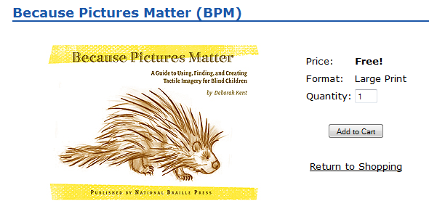

Slide 11
The Test of True Braille Literacy
Not only do graphics provide the
first step in Braille literacy, but graphics
allow students to continue into the most
advanced academic tasks, from counting
to standardized testing to physics.
http://www.nbp.org/ic/nbp/SADIE.html

Slide 12
Building Mental Images
The learning process:
Concrete 3-dimensional
Manipulative
Abstract 2-dimensional
solid drawing
outline shape

Slide 13
Building Mental Images
1. Exposure
2. Experience
3. Exploring
4. Enthusiasm

Slide 14
1. Exposure
Active involvement with others in the environment
Experience, as opposed to “just” language
Developing concepts of “chair-ness”, “nose-nes
Begin to Identify characteristics and features of things encountered

Slide 15
From Teaching Touch by Lois Harrell

Slide 16
2. Experience
Opportunity to tie things exposed to together
Begin to establish how they are related
Manipulate within the environment
(using manipulatives is vital!)
Match language with experience

Slide 17


Slide 18
Continuum of
Skill Development
Consider
Experience of learner in reading graphics
Level of cognitive development of learner
Expectations for learner’s participation
Access to equipment/supplies/instructions for communicating through graphics

Slide 19
Role of Language
4 C’s of Communication:
Compare
Categorize
Comprehend
Communicate
Notes:
London bus story

Slide 20
3. Exploring
Independently explore with intent of gathering information
Requires
  Spatial awareness
  Organized scanning skills
  Part-to-whole assembly
  Tactual discrimination (identifying symbols, selecting landmarks)
  Language skills (labels, etc.)

Slide 21
4. Enthusiasm
Success at finding information independently
Curiosity increases
Becomes “do-er” as opposed to “done to”
Positive self-concept

Slide 22
Readiness for Kindergarten
Parts of a whole
Memory for location
Object permanence
Discrimination and sorting
Spatial and weight awareness
Spatial awareness and fine motor skills

Slide 23
Beginning Tactile Perception Skills
Reader should be able to:
Track straight, curved, zigzag lines
Identify and discriminate tactile descriptors (smooth, rough, bumpy, etc.)
Identify basic shapes

Slide 24
Beginning Concept Skills
Reader should be able to:
Count
Orientation of self in space
Orientation of object in space
Orientation to page layout

Slide 25
Beginning Tactile Production Skills
Trace around hand
Trace around object
Color inside raised lines
Peel and stick textures (foam shapes) to make a picture
Use magnets of different shapes to make a picture
Make pictures on brailler
Use manipulatives

Slide 26
Teaching Graphic Literacy Resources
American Printing House for the Blind
Squid Magazine
  www.aph.org/products/presentation/squid.pps
On the Way to Literacy Books
Tangible Graphs Series
Sense of Science Series

Slide 27
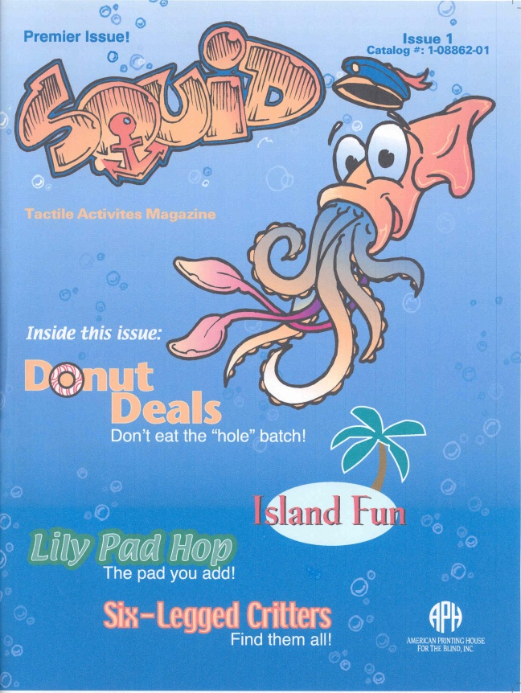
SQUID
Tactile Activities
Magazine

Slide 28

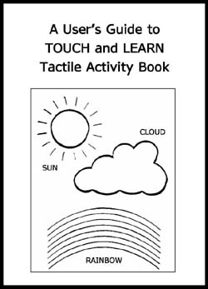

Tactile Graphics
National Braille Press & Creative Adaptations for Learning
  http://www.nbp.org/ic/nbp/TAC.html

Slide 29
Moving from the Concrete to the Abstract with Manipulatives & Graphics
Turning real objects into pictures.
Books that use thermoform pictures of real objects such as shells, pretzels, buttons, etc. so real objects can be compared to the picture.
Examples: APH: Tactile Treasures
APH: Setting the Stage

Slide 30

Math, Graphics & the
Standardized Tests?
Make the spatial connection.

Slide 31
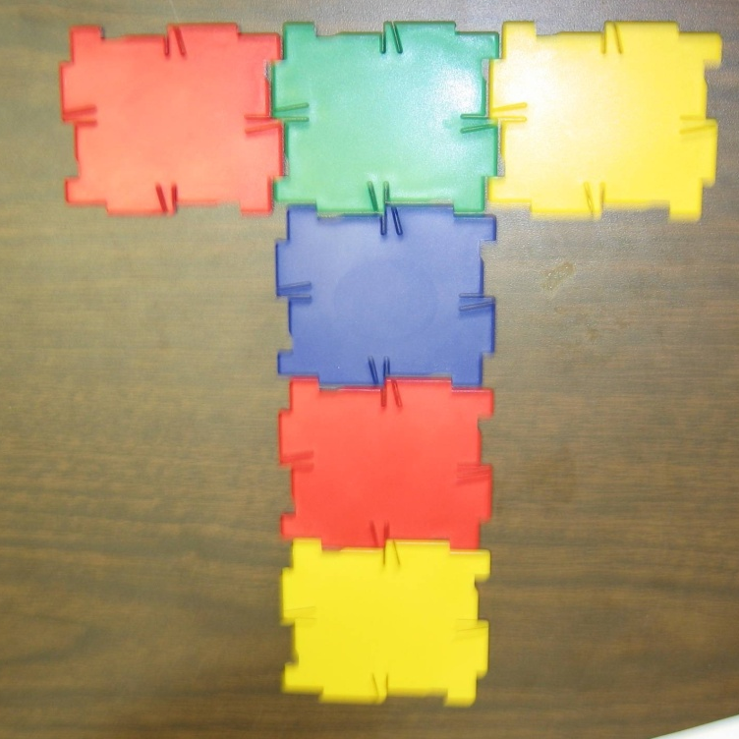
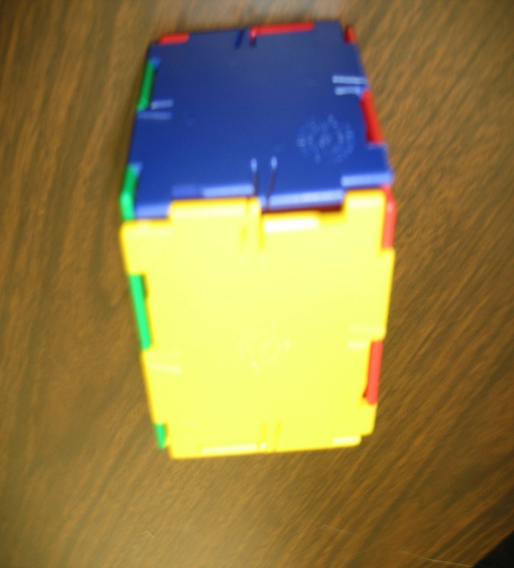
Concrete-Representational and Abstract (single dimensions to multiple dimensions)

Slide 32
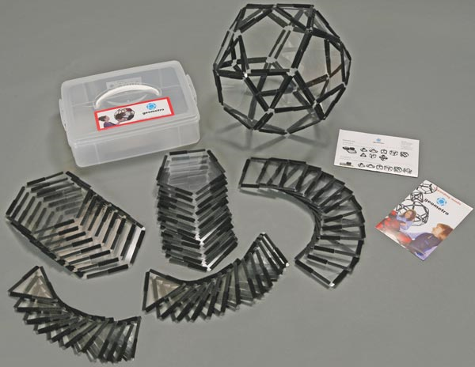
Concrete-Representational and Abstract (single dimensions to multiple dimensions)

Slide 33
Students must READ and WRITE
State standards require that students demonstrate knowledge of concepts being taught through
Interpreting a graphic
Gathering data and producing a graphic
Comparing several stages of a process
  Performing mathematical tasks
  (tadpole to frog, caterpillar to butterfly)

Slide 34
School tasks for K-3
Demonstrate understanding of educational concepts:
Construct graphs (bar, line, pie)
Draw geometric shapes
Draw processes, stages
Produce or fill in maps, diagrams

Slide 35
Simple Graphic is better than No Graphic
Graphic with glue, puff paint, yarn, etc.
http://www.wikkistix.com/
Use a variety of simple drawing kits such as the Picture Maker from APH.

Slide 36
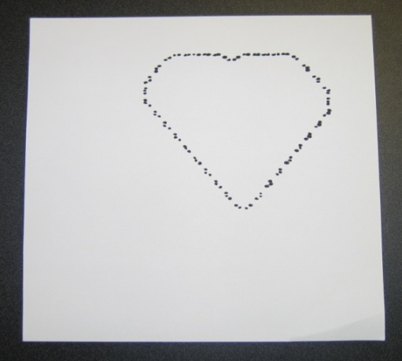
Raised Line Coloring Experiences
Raised line coloring books
http://www.tactilevisioninc.com
Drawing on a Perkins or Mountbatten Brailler
  reinforces Braille contractions and use of formatting.
  Engages the child in Braille learning with a creative mind set.
  Helps to develop interaction between blind and sighted children.

Slide 37
Instant Graphics
(microcapsule/swell technology)
Draw, print, or copy onto swell paper.
  Blind students can analyze their handwriting
  Blind parents can see the sighted child’s written work and artistic creations.
  Copy any image, logo, or print chart.
http://www.humanware.com/en-usa/products/braille_and_speech/braille_embossers_and_writers/_details/id_94/piaf.html
http://americanthermoform.com/swell.htm
http://www.repro-tronics.com/tie.html

Slide 38
Embossed Graphics
All Braille Embossers are NOT graphics capable.
Make sure graphics become a vital part of the braille curriculum and that pictures are no longer omitted from materials you emboss.

Slide 39
Embossed Graphics
Tiger Suite comes free with the purchase of any ViewPlus Embosser.
Firebird suite comes free with the purchase of the Phoenix embosser.
http://www.viewplus.com/images/EmprintSpotDot_Fire+Ice_800.jpg
http://brailler.com/phoenix.htm

Slide 40

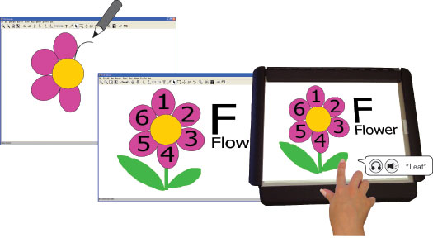
The Power of a Multisensory Approach
Combine tactile, auditory, and in some cases visual feedback for the optimal learning process.
IVEO
Talking Tactile Tablet

Slide 41
Talking Tactile Tablet
Includes Match Game, single World Map, and 3 authoring templates sheets with 30 day demo of Authoring Tool. $699.00
National Geographic World Atlas, flags of the world, crossword puzzles, fully accessible Authoring Tool, Braille learning courseware, and statistics packet available (sold separately).
http://www.touchgraphics.com/catalog/popup_image.php?pID=33

Slide 42
The Power of Graphic Literacy and Technology
Dr. Kent Cullers, the world’s first blind astronomer said it this way in the book, Touch the Universe: “It has often been said that a picture is worth a thousand words. Well, for the first time in my career, I get the picture.”
http://www.youcandoastronomy.com/

Slide 43
Download this powerpoint
www.TactileGraphics.org
Email:
Lucia@tactilegraphics.org
dwilkinson@eastersealsar.com

